Slide 1
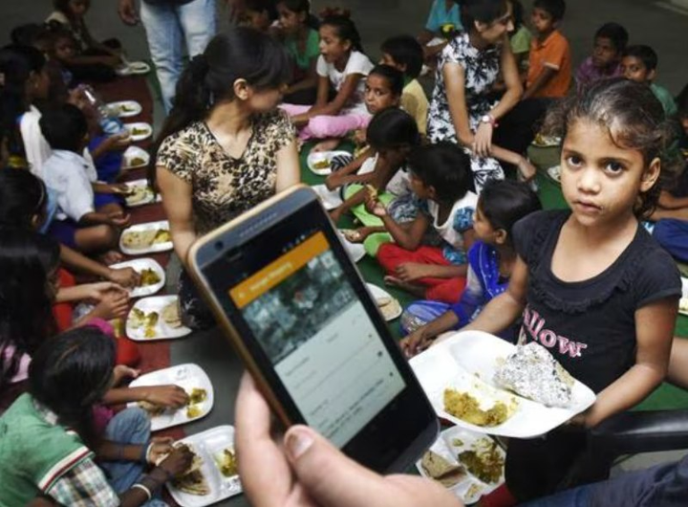
DATABASE SYSTEMS ENGINEERING AND DISTRIBUTED BACKEND DEVELOPMENT (25CS1302E)
Food Donation & NGO Connect App
Team Members:
2520030158 - S.Anusha
2520030161 - M.Srinikitha
2520030216 - D.Deekshitha
Section:
08

Slide 2
ABSTRACT
The Food Donation & NGO Connect App is a full-stack application designed to reduce food wastage by connecting food donors such as households, restaurants, and organizations with NGOs. The application allows donors to share details about surplus food, including its type, quantity, location, and availability, while NGOs can view suitable donations and manage donation requests. The system uses databases, REST APIs, authentication, and a microservices-oriented approach to provide a scalable and reliable platform. The main aim is to improve coordination and ensure the timely distribution of surplus food to people in need.

Slide 3
PROBLEM
STATEMENT
  Food wastage is a major issue, while many people are still in need of food.
  There is a lack of an efficient platform connecting food donors with NGOs.
  Donors often face difficulties in sharing information about surplus food, quantity, location, and availability.
  NGOs may struggle to identify suitable food donations and manage requests efficiently.
  Lack of proper coordination can lead to delays in collecting and distributing surplus food.
  Therefore, a centralized and reliable application is needed to improve coordination and ensure surplus food reaches people in need on time.

Slide 4
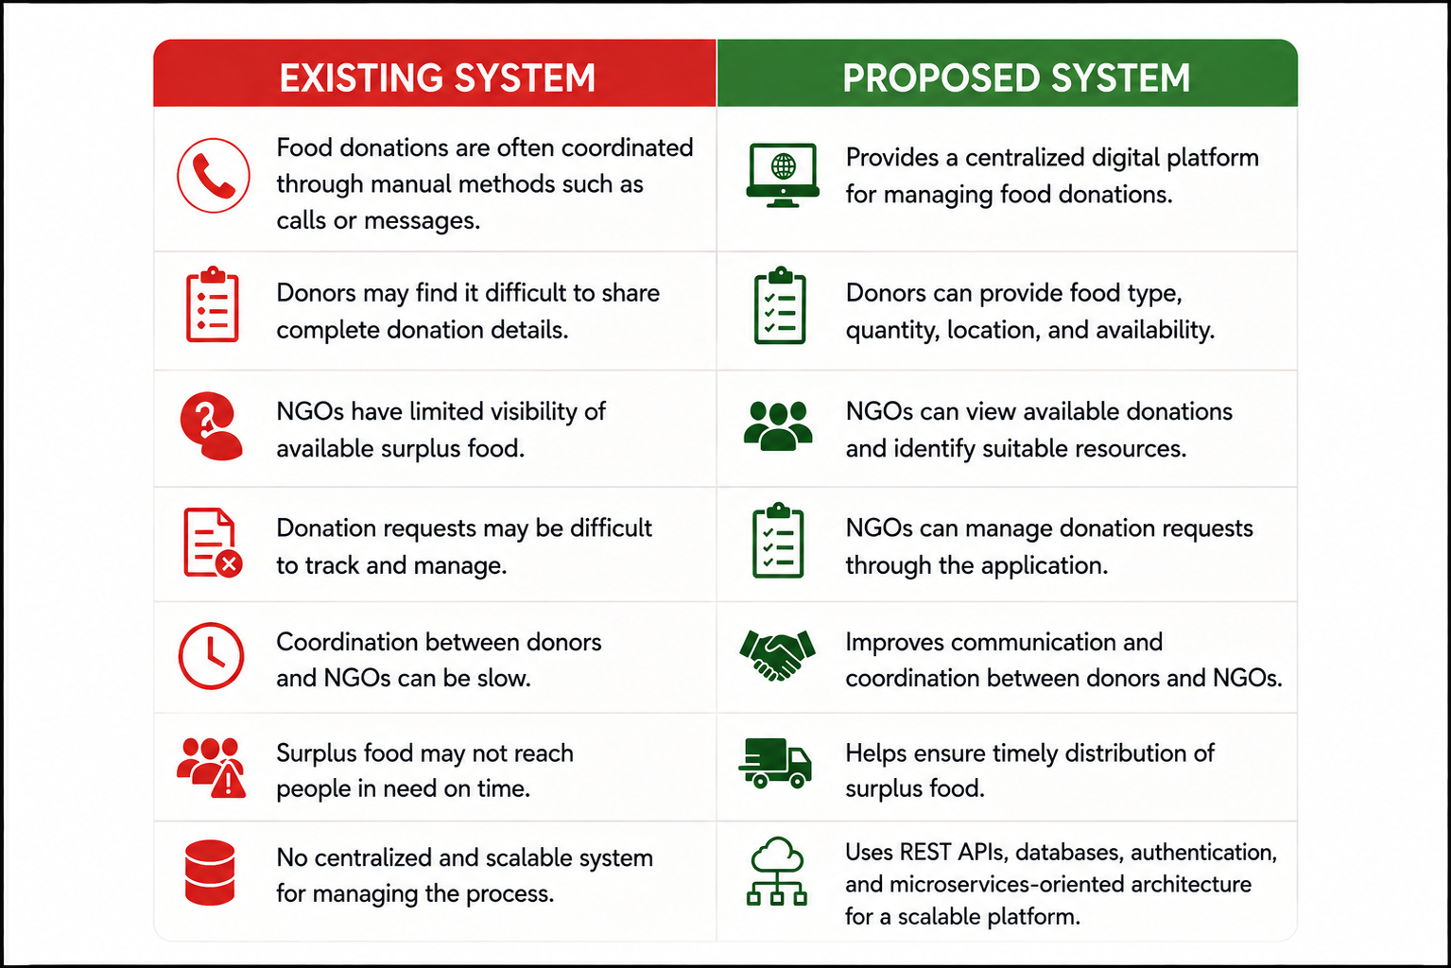
EXISTING VS PROPOSED SYSTEM

Slide 5
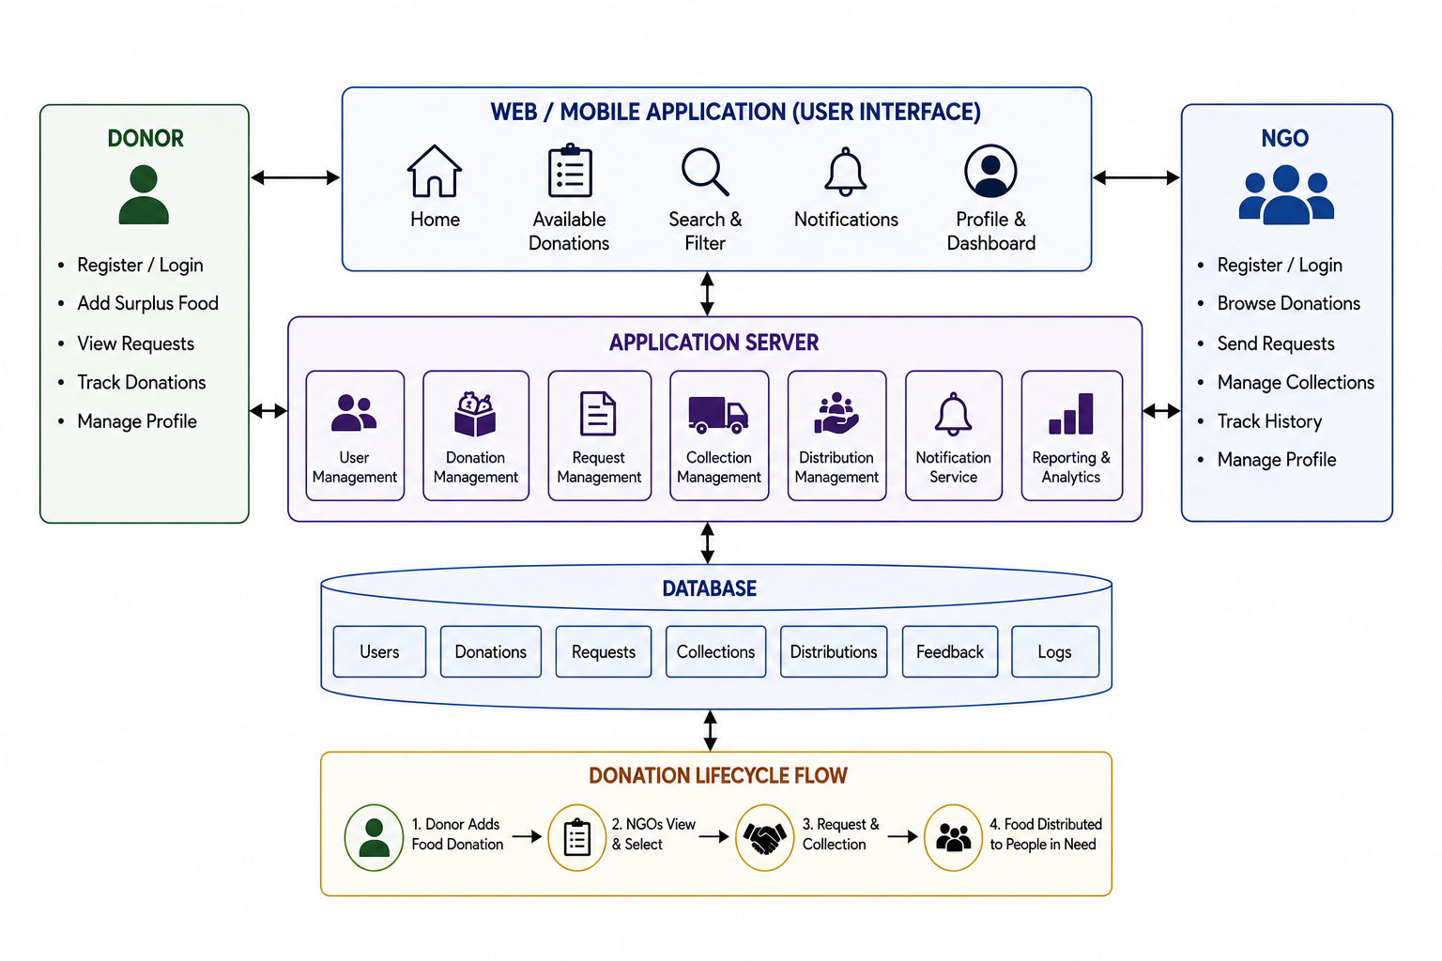
PROPOSED SYSTEM ARCHITECTURE

Slide 6
TOOLS
  React.js – Used to build the user interface.
  HTML – Used to create the webpage structure.
  CSS – Used for design and styling.
  JavaScript – Used to add interactive features.
  FastAPI – Used to develop the backend and REST APIs.
  MySQL / PostgreSQL – Used to store structured data.
  MongoDB – Used to store flexible data.
  REST API – Used for communication between frontend and backend.
  JWT – Used for secure user authentication.
  Git & GitHub – Used for code management and version control.
  Postman – Used to test backend APIs.
  Visual Studio Code – Used for coding and development.

Slide 7
Thank you

